Slide 1
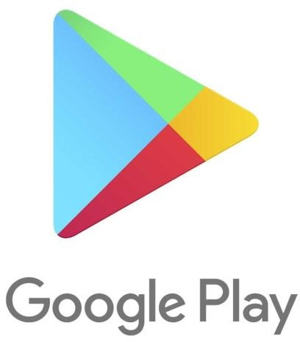
Capstone Project
Play store App Review
Presented By : SAKSHI.R.GHUGARE

Slide 2

Content
Introduction
Objective
Problem Statement
Description of Data
Cleaning the Data
Data analysis and visualizations
Conclusion
Challenges

Slide 3

Introduction
Play store is an Android Market serves as the official app store for certified
devices running on the Android Operating system.
Developed and Operated by Google, launched on 6th March, 2012.
Also called as Google Play store.
Approximately 3.48 million apps are in Play store.
Each apps are having separate product page with user review and rating
system.
All the apps are separated into different categories based on the purpose
Lots of designers and developers work on it make an app successful on the
play store

Slide 4
Objectives
The objective of this is to analyze the desire of the customer through the reviews provided in the feedback section and apps trend in the market to help the organization & developers.
Find the most popular and trending apps in recent times.
Find how small changes or update impacts on app performances Analyze the Reviews, Rating, Sentiments of people towards various apps in play store.
Above all, help developers or Clients to recognize the gap, make the app better and
meet customer expectations.

Slide 5
Problem statement
What are the top 10 apps available per category in Play store?
How many no of installs are there per category? What are the top two categories are observed?
What are the top 30 Genres for free installation?
What are the top 30 Genres for paid installation?
What are the top apps in play store based on review?
What are the mean rating for all categories?
What is the Rating distribution for apps?
What are the Types of Content rating for the apps?
Whether or not does the size of app matters?

Slide 6
Description of Dataset
There are two datasets :
1) Play store data :
App Category Rating Review Size Installs Type Price
Content rating Genres
Last Updated
- Name of the application
Category of the application
Rating given to the application
Numbers of reviews given to the application
- Size of the application
- Numbers of downloads of the application
- Free or Paid
Price of the application if it is paid
It is Age appropriate or not
Type of Genre the application belongs to
When the last time the application is updated
Current version - Current version of the application
Android version - Min android version required to run the application

Slide 7
2) User Review Data:
App : An app name
Translated Review :Reviews being given by consumer.
Sentiment :Sentiment given to an app by users (i.e. Positive, Neutral, Negative)
Sentiment Polarity : The polarity of sentiment measures how negative or positive.
The context : In the data we have, the polarity ranges from +1(Positive) to -1(Negative).
Sentiment Subjectivity: The subjectivity of a sentiment is how likely that sentiment is to be based on data of factual information, versus personal opinions or public opinions

Slide 8

Data cleaning
When using data, most people agree that your insights and analysis are only as good as the data you are using. Essentially, garbage data in is garbage analysis out.
What is data cleaning?
Data cleaning is the process of fixing or removing incorrect, corrupted, incorrectly formatted,
duplicate, or incomplete data within a dataset.
Data cleaning, also referred to as data cleansing and data scrubbing, is one of the most important steps for your organization if you want to create a culture around quality data decision-making

Slide 9
Steps for data cleaning
Step 1: Remove duplicate or irrelevant observations
Remove unwanted observations from your dataset, including duplicate observations or irrelevant observations. Duplicate observations will happen most often during data collection
Step 2: Fix structural errors
Structural errors are when you measure or transfer data and notice strange naming conventions, typos, or incorrect capitalization.
Step 3: Filter unwanted outliers
this is use for removing incorrect and unwanted outlier
Step 4: Handle missing data
Fixing mislabeled categories or classes, Types , Strange name conventions
Replacing missing values with mean, median or mode: Replacing missing values

Slide 10
Exploratory Analysis and Visualization
In statistics, exploratory data analysis is an approach to analyzing data sets to summarize their main characteristics, often with visual methods. A statistical model can be used or not, but primarily EDA is for seeing what the data can tell us beyond the formal modeling or hypothesis testing task. Data visualization is the graphic representation of data. It involves producing images that communicate relationships among the represented data to viewers of the images.

Slide 11
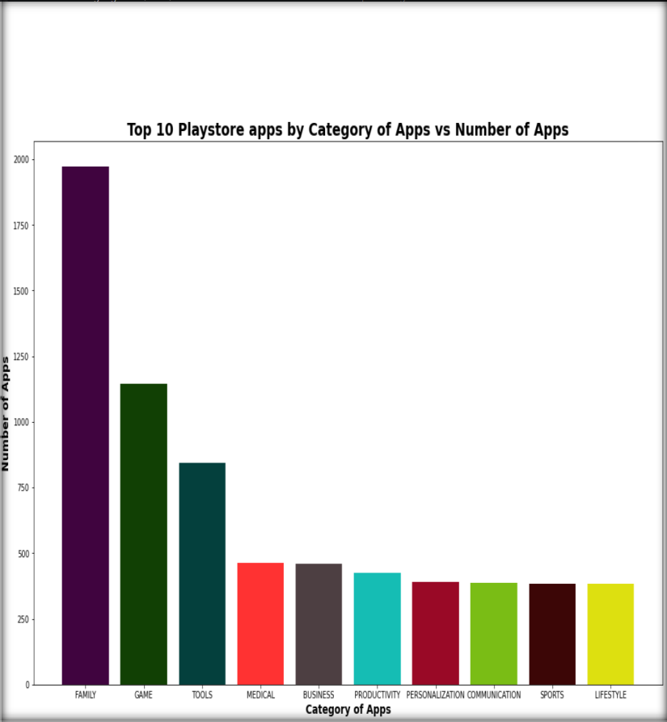
Top 10 play store apps by category of apps Vs number of apps
As we saw here, the Play store having more number of applications in the genres like Tools, Entertainment, Education and etc.
The developers are mostly focusing on these genres because of the people's daily basis requirements.
Genres like Educational, Parenting, Music are
having comparatively less.

Slide 12
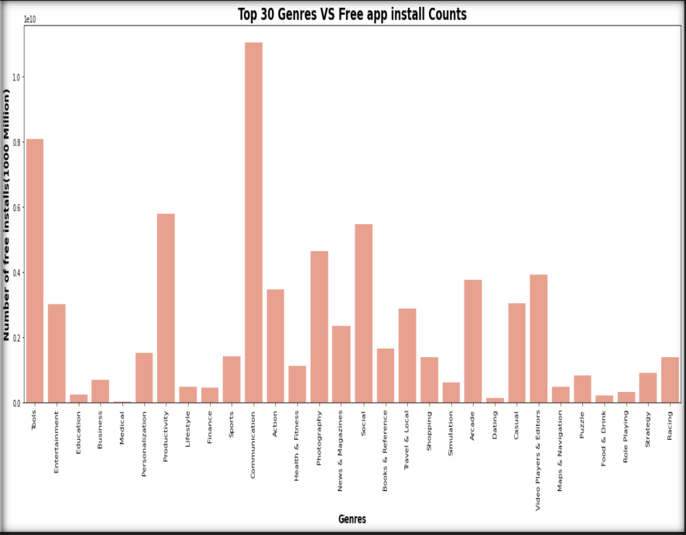
Top 30 genres Vs free app install counts
When comparing the both plots, people are showing more interest on free apps like communication, Tools etc
Again the Educational, Parenting and Music are the genres in the least Top free apps When it’s coming, commercial people are
preferring apps like Games, Photography, and Personalization.
People are preferring less on Educational, Event, and Art & Design.

Slide 13
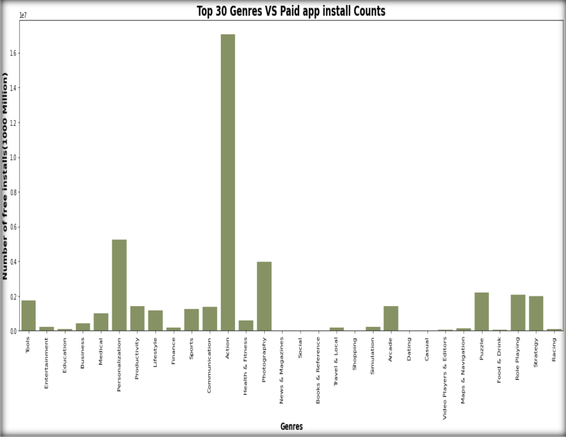
Top 30 genres vs paid app install count
When it’s coming, commercial people are preferring apps like Games, Photography, and Personalization.
People are preferring less on Educational, Event, and Art & Design.

Slide 14
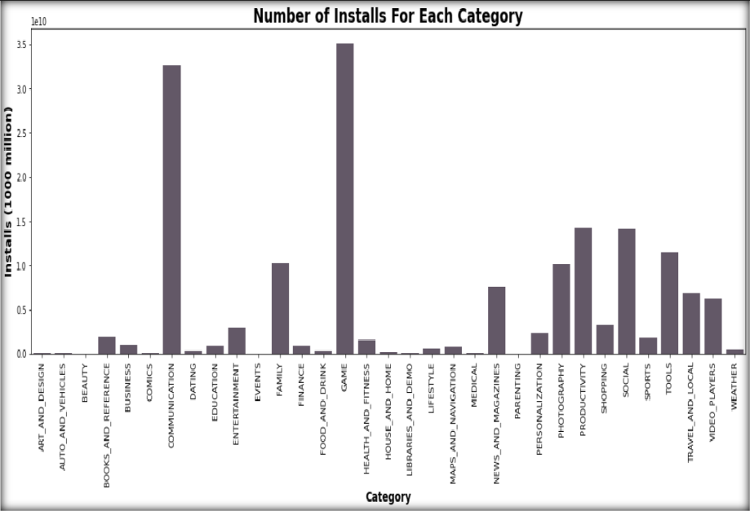
Number of installs for each
category
From this Bar it is observed that "Game" and "Communication" Category has the most number of Installs.

Slide 15
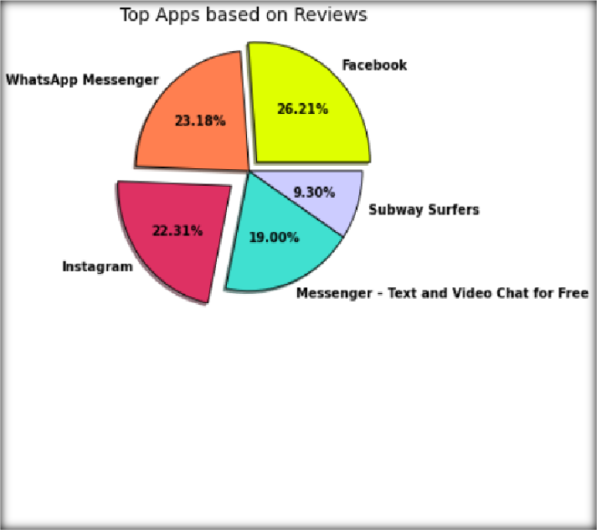
Top apps based on reviews
As seen from the above Pie Chart "Facebook" and "Whatsapp“ have the most number of Reviews with 26.21% and 23.18% respectively

Slide 16
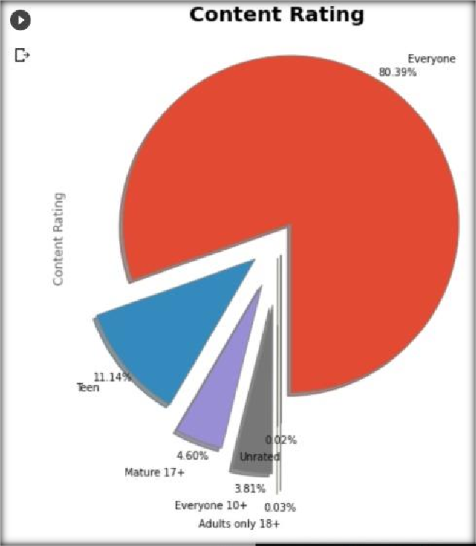
Content Rating
The content rating shows the results for general contents as high.
The content rating type ‘Everyone’ has the most
percentage value of 80.39%.
‘Teen’ contents are second in the order with the percentage of 11.14%.
Adult’s only and unrated contents are least in this
plot, 0.03% and 0.02% respectively.

Slide 17
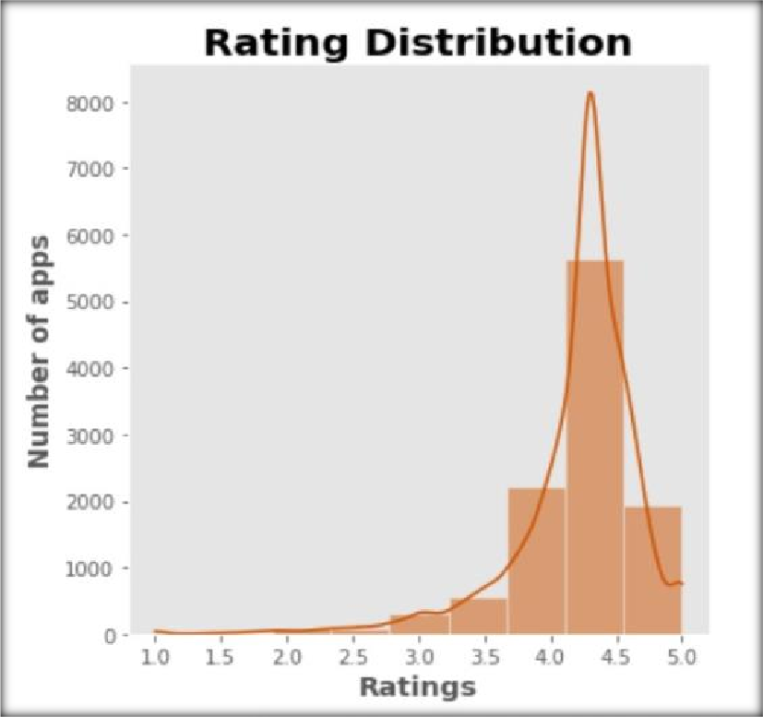
Rating distribution
From this distribution plotting, it is observed that most of the apps in the Play Store have the rating between 4 to 4.5 out of 5 which shows that most of the apps on play store are liked by the users.

Slide 18
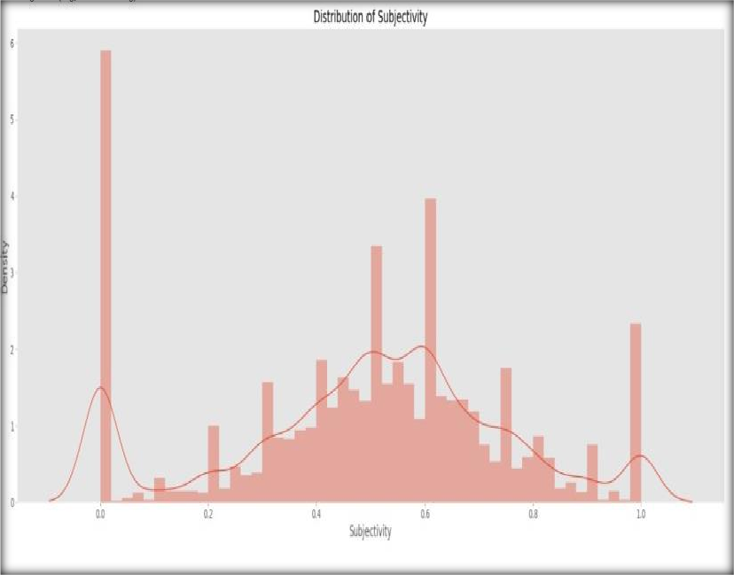
Distribution of Subjectivity
Subjectivity lies mostly between 0.5 and 0.65.
It shows that the average content and apps reviews
subjectivity are mostly relevant.
Subjectivity of 100% has slightly occurred frequently.
The nearly 0 subjectivity has a considerable amount of
frequency.

Slide 19
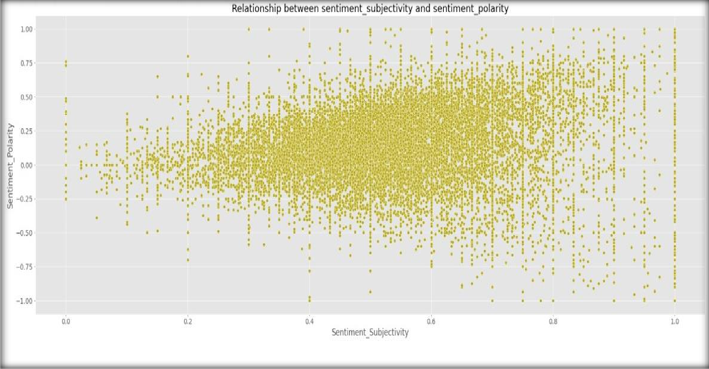
Relationship between sentiment subjectivity and sentiment polarity
From the above scatter plot it can be observed that sentiment subjectivity is not always proportional to sentiment polarity but in maximum number of case, shows a proportional behavior, when variance is too high or low

Slide 20
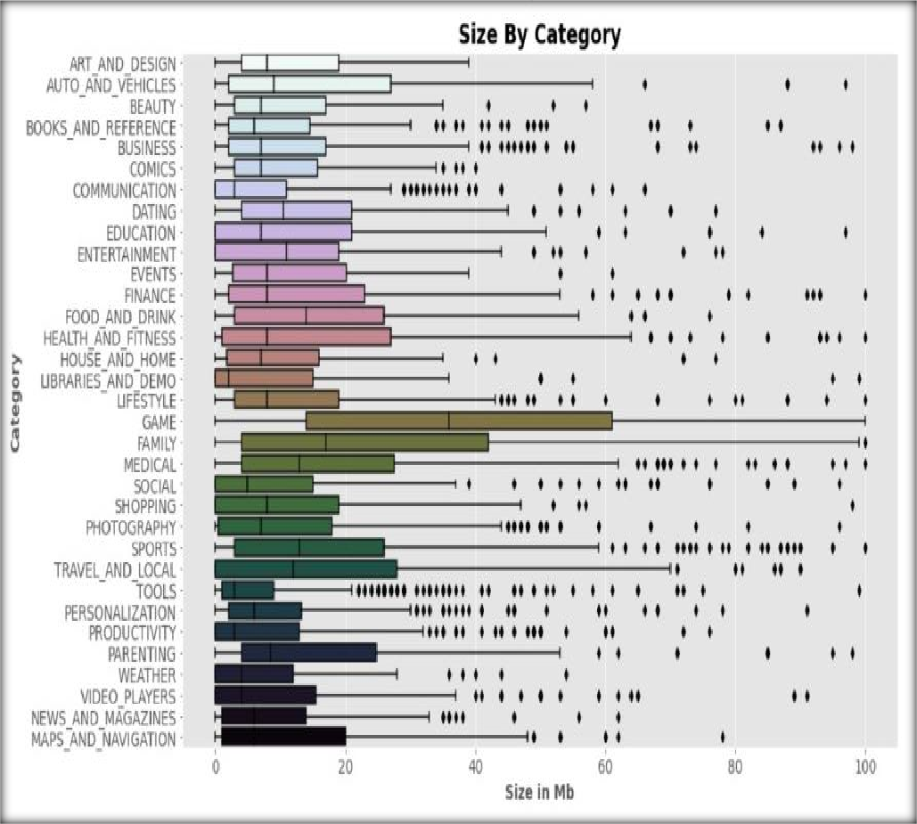
Size of the apps
Majority of the apps installed are no
more than 100 megabytes in size.
This shows that size does matter. Most consumers don't want to download apps that takes up too much space on their device storage

Slide 21
CONCLUSION
Thus the app development companies could decide what application should be developed and they can also see the prediction of their developed application. In this they also get to see the categorized reviews of all the application in one interface which will help them decide which app is liked by the users and which apps need to be developed more. The dataset contains immense possibilities to improve business values and have a positive impact. It is not limited to the problem taken into consideration for this project.

Slide 22
CONCLUSION
App Rating is directly proportional with the recent updates. from this we can be sure that with the latest updatation the reviewers are giving better ratings.
We found that Action Genres got most strong positive sentiment among all genres. It suggest that people prefers Action genres app far more than any other genres.
Google play store has more free apps than paid and Family category has most free and paid apps in play store. MEDICAL category has highest amount of paid apps considering quantity followed by GAME TOOLS Category
We found that in terms of both Top Total and Average Apps Reviews outcomes Facebook, Instagram, whatsapp messanger, messangers for chat these apps are common. so we can conclude that these 4 apps are most populars and trending amongs masses

Slide 23
Challenges
Huge chunk of data was to be handled keeping in mind not to miss anything which is even of the little relevance.
Computation time

Slide 24
THANK -YOU

